Slide 1
Proof Structure and Neural Theorem Proving
Riyaz Ahuja

Slide 2
Table of Contents
On Recent NTP Results
Is “Structure” Useful?
Proof Optimization
Previous Work
ImProver²
Formal Proof Structure
Results
Bootstrapping SLMs with Off-Policy Expert Iteration
“Structure” is Useful.

Slide 3
In the beginning*, we had MCTS:
HTPS:
First really influential AlphaZero-style search procedure for neural theorem proving
Tree search over proof states with value/policy network guidance, and online training from the search itself
Improved SoTA on miniF2F to 41%
BFS-Prover:
Instead of MCTS or HTPS, uses a best first search over proof states. Given as an inference time algorithm over DeepSeek-Prover-V1.5 and scored via DPO on proof traces.
Beats its DSP1.5 baseline by 7-10 points on MiniF2F (70.83%)
On Recent NTP Results
*Not really the beginning

Slide 4
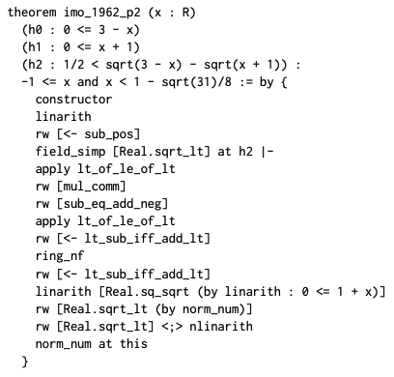
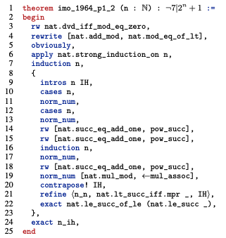
In the beginning*, we had MCTS:
HTPS:
BFS-Prover:
On Recent NTP Results
*Not really the beginning

Slide 5
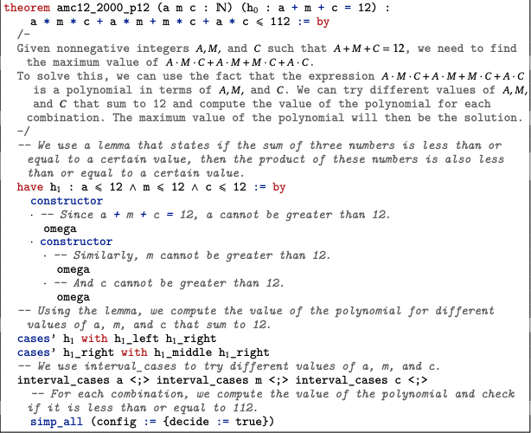
And simple LLM provers:
DeepSeek-Prover-v1.5:
Pre-train on informal math + formal math.
Fine-tune on formal theorems/proofs from DeepSeek-Prover-V1.
RL from Lean compilation signal.
Also has a MCTS variant for test time exploration.
SoTA on MiniF2F at 63.5%
On Recent NTP Results

Slide 6
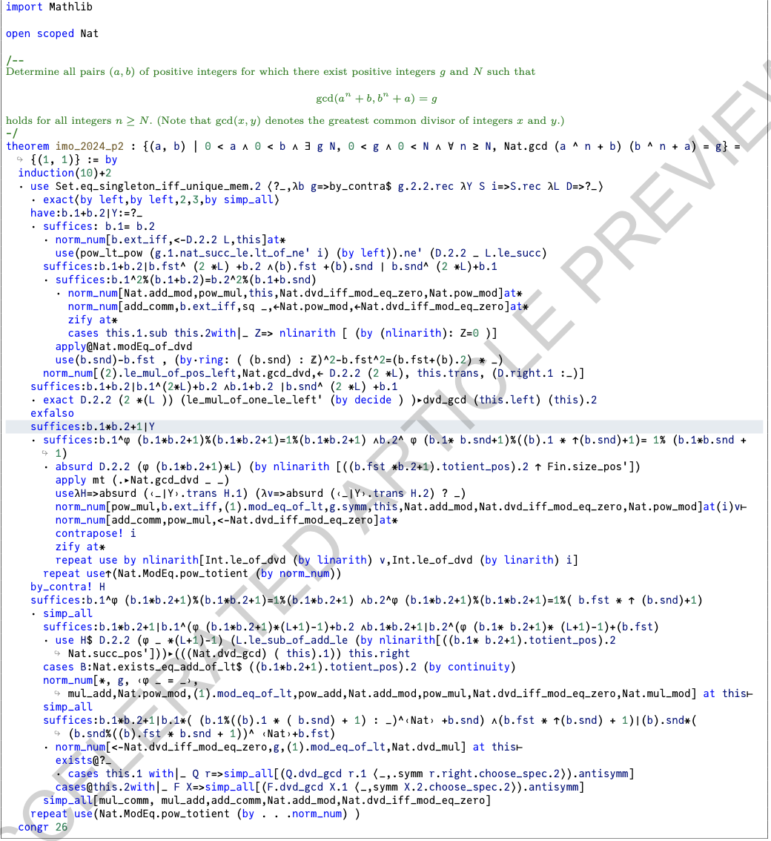
And then, less simple ones as well:
AlphaProof:
Autoformalize ~100M formal theorems, and use them in an EI+RL loop: generate proofs with search, train a policy/value network on successful (compiling) ones.
Test-time online RL to adapt to a given problem at test time.
4/6 IMO
(Not as much informal reasoning; is a 3B encoder-decoder model!)
On Recent NTP Results

Slide 7
Then, came along subgoal decomposition:
DeepSeek-Prover-v2:
Cold-start via subgoal decomposition: prompt DeepSeek-V3 to decompose problems and sketch their proofs. Use this to build a (subgoal, proof, CoT) dataset.
Initialize DSP2 from this and then RL on Lean compiler feedback.
88.9% MiniF2F (SoTA) and 49 Putnam problems solved.
Kimina-Prover:
Scaled up Qwen2.5-72B for NTP, introducing a structured formal reasoning “pattern”
Model CoT decomposes proof into a stepwise reasoning trace in Lean
RL optimizes the pattern
80.7% MinF2F (SoTA)
On Recent NTP Results

Slide 8
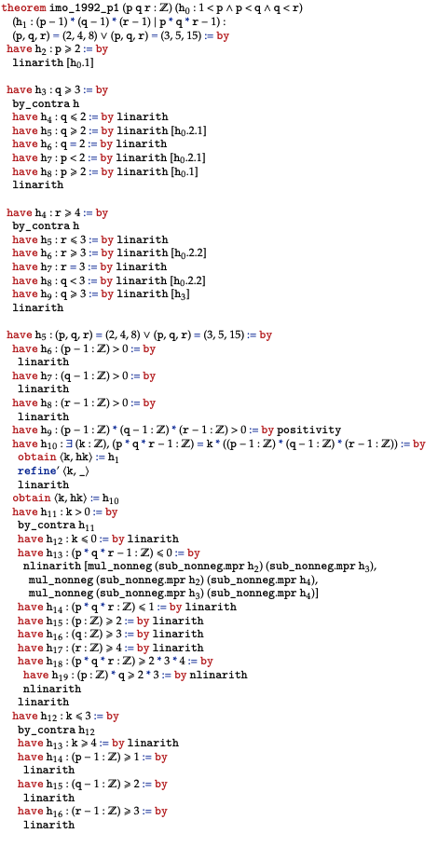
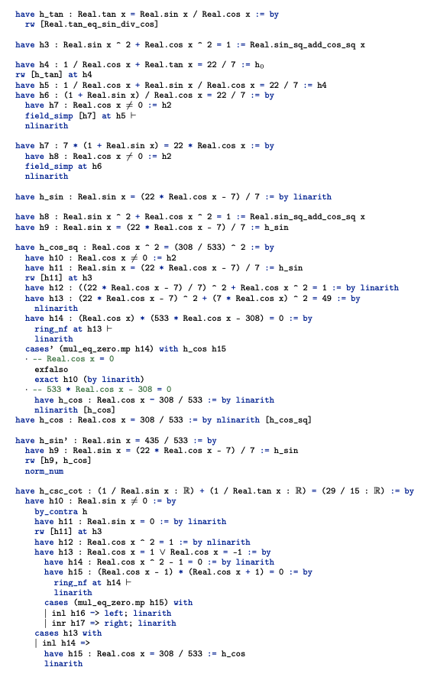
Then, came along subgoal decomposition:
DeepSeek-Prover-v2:
Kimina-Prover:
On Recent NTP Results

Slide 9
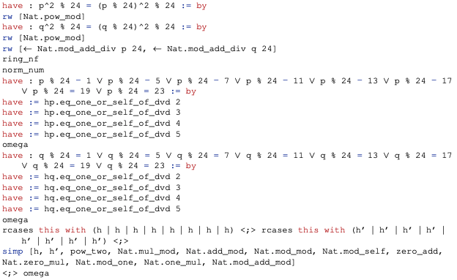
And self-play:
STP-Prover:
Conjecturer-Prover loop, where model generates its own curriculum of new theorems:
Conjecturer proposes new conjectures just beyond the current prover’s reach
Prover tries to prove these theorems with expert iteration.
8 putnam problems and 65% MiniF2F
Goedel-Prover-v2:
Goedel-Prover-v1 used a large autoformalization stage and expert iteration - data scaling.
V2 improves this by generating synthetic tasks of increasing difficulting to train harder prover, and then use Lean feedback to self-correct within a trajectory.
Run this pipeline in a standard RL + Expert iteration pipeline.
84.6% MiniF2F and 86 Putnam Problems.
On Recent NTP Results

Slide 10
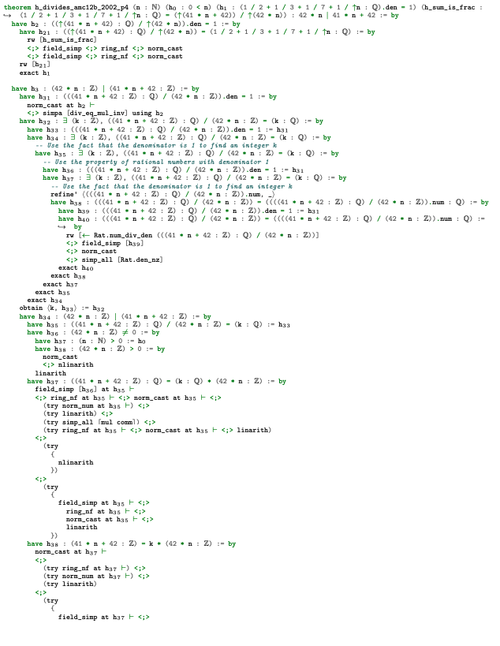
And now at SoTA:
Seed-Prover:
Builds on previous work heavily with large emphasis on lemma and conjecture generation and iterative refinement.
Saturates MiniF2F, Gold IMO (5/6), >50% on PutnamBench.
Hilbert:
Agentic framework - General LLM for informal reasoning, and a formal prover LLM.
Recursively decomposes the problem into subgoals, and routes the subgoals to either the prover or informal engine.
Saturates MiniF2F, solves 70% of PutnamBench.
On Recent NTP Results

Slide 11
Patterns
Proof Style: Linear → Tree-like
Generation Strategy: Tactic-Level Generation → Incremental Proof & Lemma Generation
In general, we observe performance increasing and proof “structure” improving correlationally over time. Additionally, the majority of methods begin to converge on a Draft-Sketch-Prove approach w/ lemma generation. So:
Performance ～ “Proof Shape”?
Or Performance ～ Generation Strategy?
On Recent NTP Results

Slide 12
Is this “Structure” Useful?
All else being equal, does training on better “structured” proofs result in better downstream theorem prover performance?
Hassan Khoury ©

Slide 13
High level:
Base Model
Evaluation
Dataset
Training
Neural Theorem Prover
Proof Optimization
Structure-Optimized Dataset
Neural Theorem Prover
So, how does one structurally optimize a dataset? What does that even mean?
Is this “Structure” Useful?

Slide 14
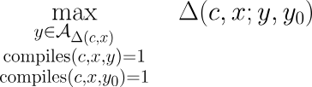

Proof Optimization
Given a theorem statement x in context c with an initial proof y, we want to generate a new proof y’ such that compiles(c,x,y’), and given either an absolute metric or a relative metric
we aim to maximize:
Or, if we want to specify some additional requirements for a “valid proof” for a given metric (i.e. ignore trivial optimizations), we can define an admission set and consider the improvement score:
Meaning that we would like to optimize for
Note that the task of proof optimization is a proper generalization of neural theorem proving as well as autoformalization.
Proof Optimization

Slide 15
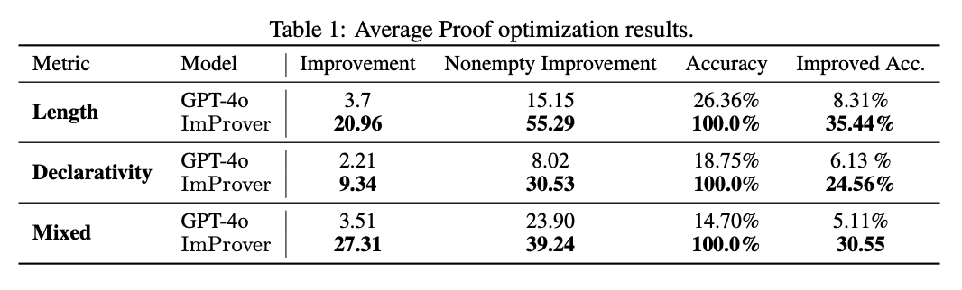
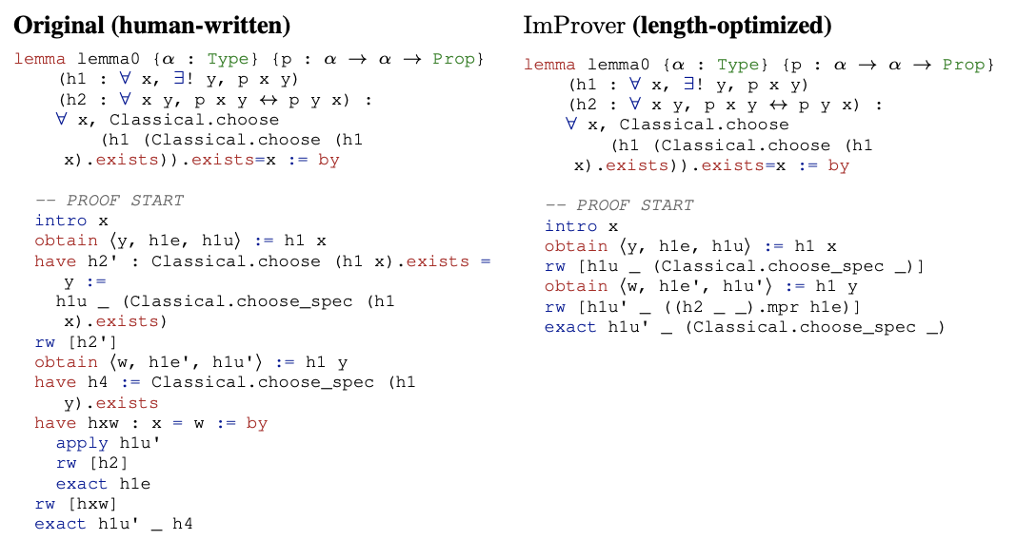
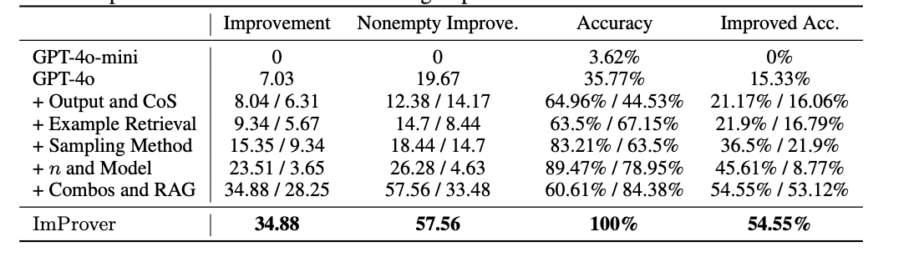
ImProver
Previous Work

Slide 16
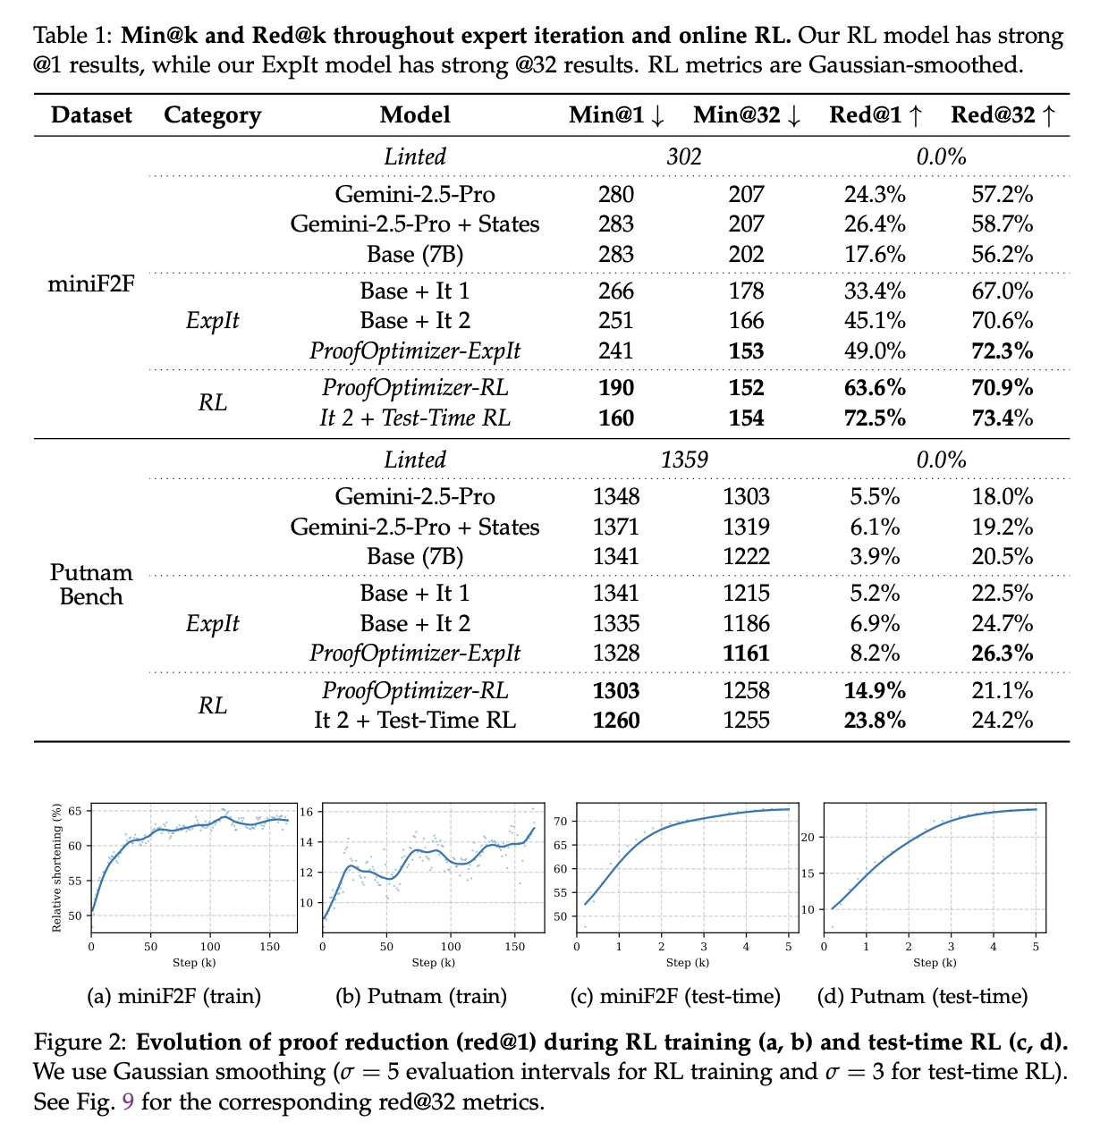
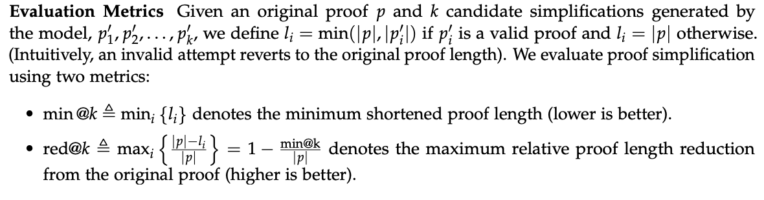
ProofOptimizer
Previous Work

Slide 17
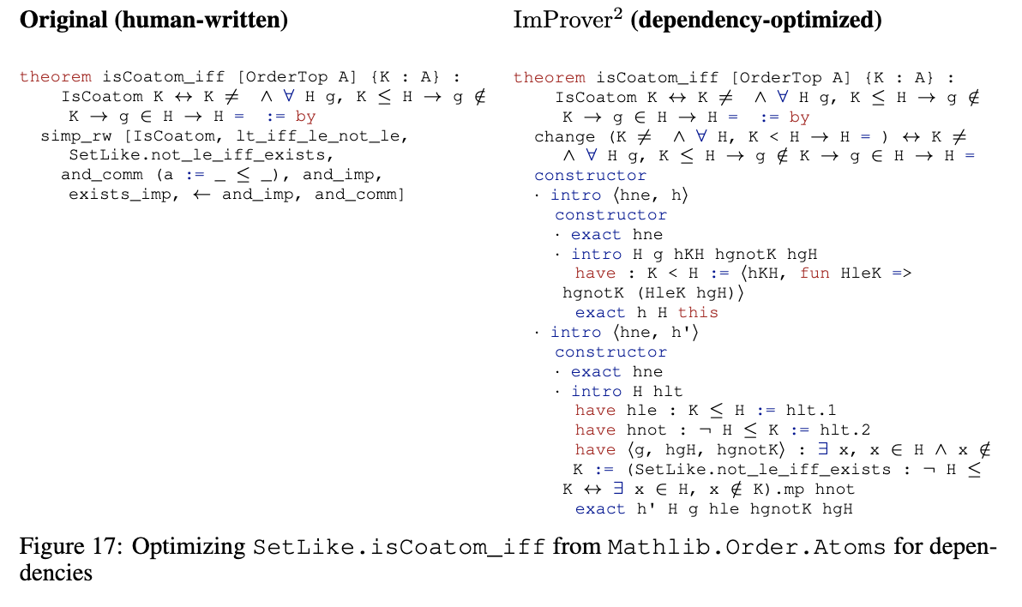
ImProver²
Objectives:
Build a general method that allows for simple proof optimization to arbitrary metrics
Test this method on real-world, utility-focused metrics
Build a training pipeline that can optimize many different metrics without much/any manual tuning on small parameter models, that allows them to perform competitively with much larger models.
Do all of the above on research math
Previous Work

Slide 18
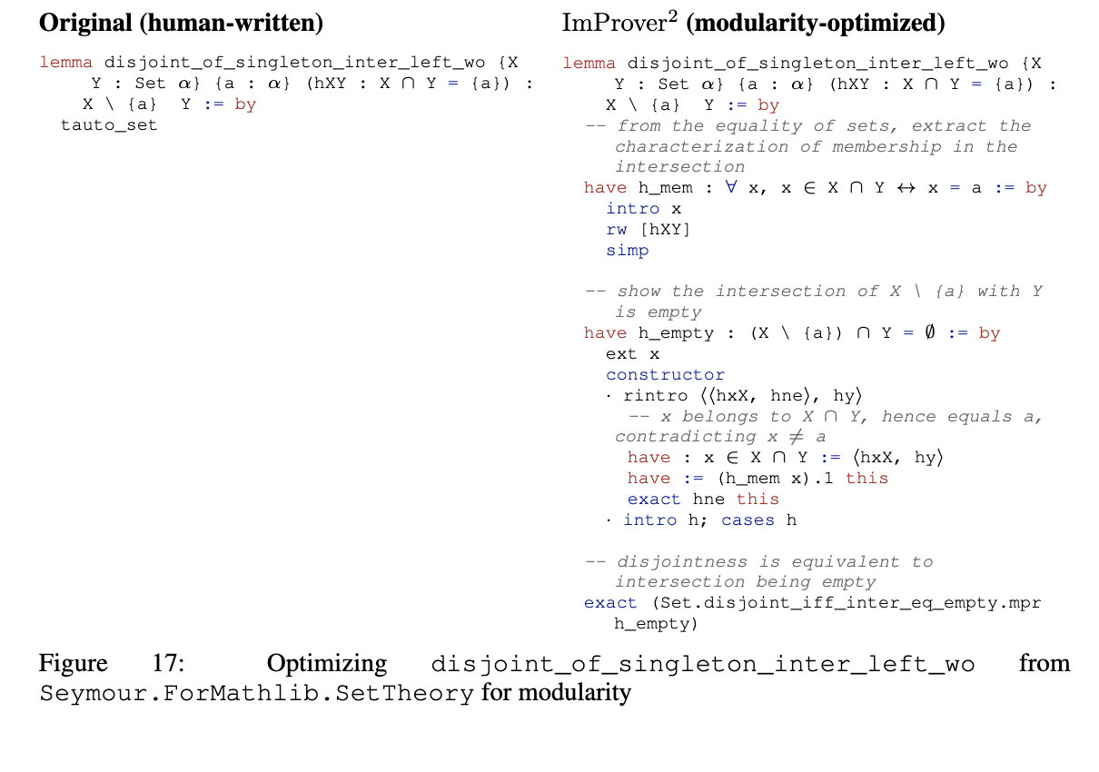
ImProver²
Objectives:
Build a general method that allows for simple proof optimization to arbitrary metrics
Test this method on real-world, utility-focused metrics
Build a training pipeline that can optimize many different metrics without much/any manual tuning on small parameter models, that allows them to perform competitively with much larger models.
Do all of the above on research math
ImProver²

Slide 19
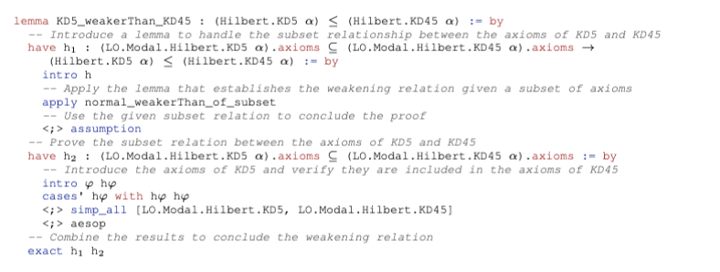
Proof Modularity
Proof Modularity is the number of spawned goals, that are:
critical to the correctness of the proof
nonduplicates
nontrivial
Formal Proof Structure

Slide 20
Proof Modularity
have h₁ : [...] := by
exact h₁ h₂
have h₂ : [...] := by
intro h
Proof Modularity is the number of spawned goals, that are:
critical to the correctness of the proof
nonduplicates
nontrivial
intro φ hφ
apply normal_weakerThan_of_subset
cases' hφ with hφ hφ
assumption
simp_all [LO.Modal.Hilbert.KD5, LO.Modal.Hilbert.KD45]
simp_all [LO.Modal.Hilbert.KD5, LO.Modal.Hilbert.KD45]
aesop
Formal Proof Structure

Slide 21
Proof Modularity
have h₁ : [...] := by
exact h₁ h₂
have h₂ : [...] := by
intro h
Proof Modularity is the number of spawned goals, that are:
critical to the correctness of the proof
nonduplicates
nontrivial
intro φ hφ
apply normal_weakerThan_of_subset
cases' hφ with hφ hφ
assumption
simp_all [LO.Modal.Hilbert.KD5, LO.Modal.Hilbert.KD45]
simp_all [LO.Modal.Hilbert.KD5, LO.Modal.Hilbert.KD45]
aesop
Formal Proof Structure

Slide 22
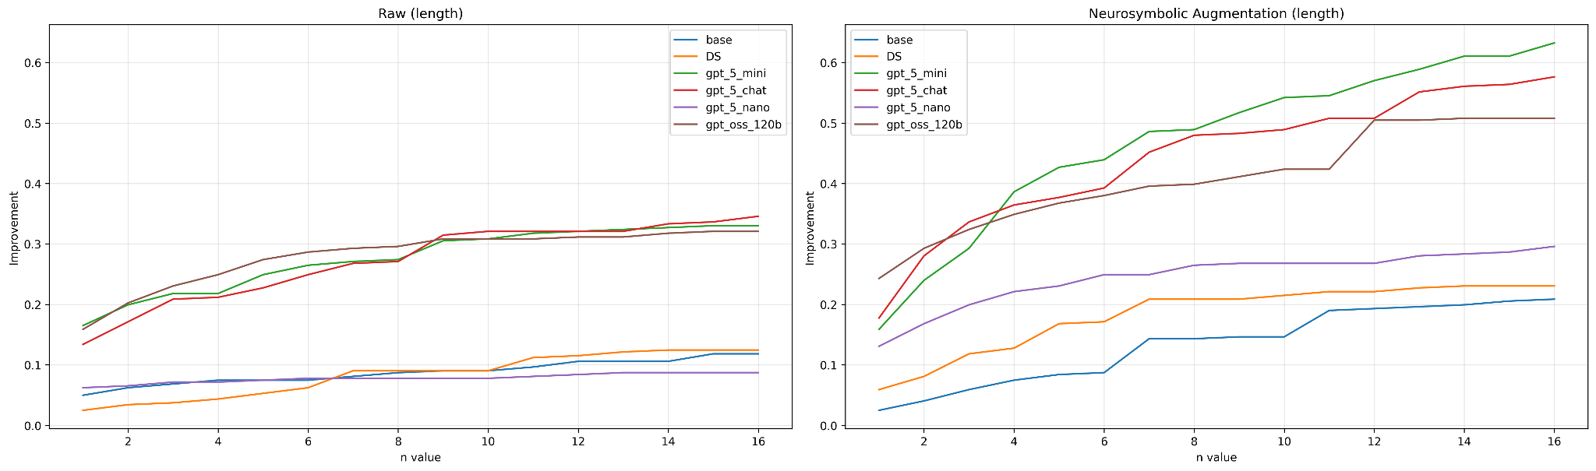
(Preliminary) Results
Results

Slide 23
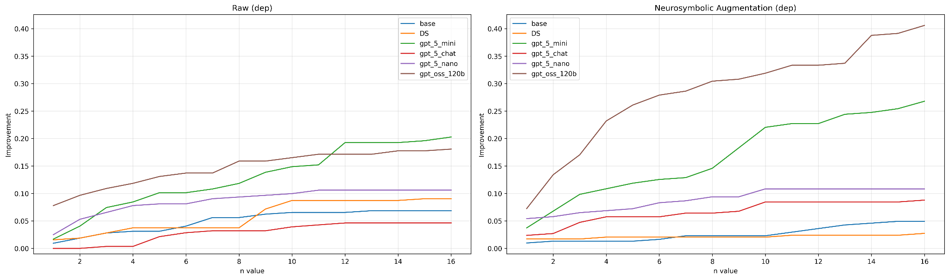
(Preliminary) Results
Results

Slide 24
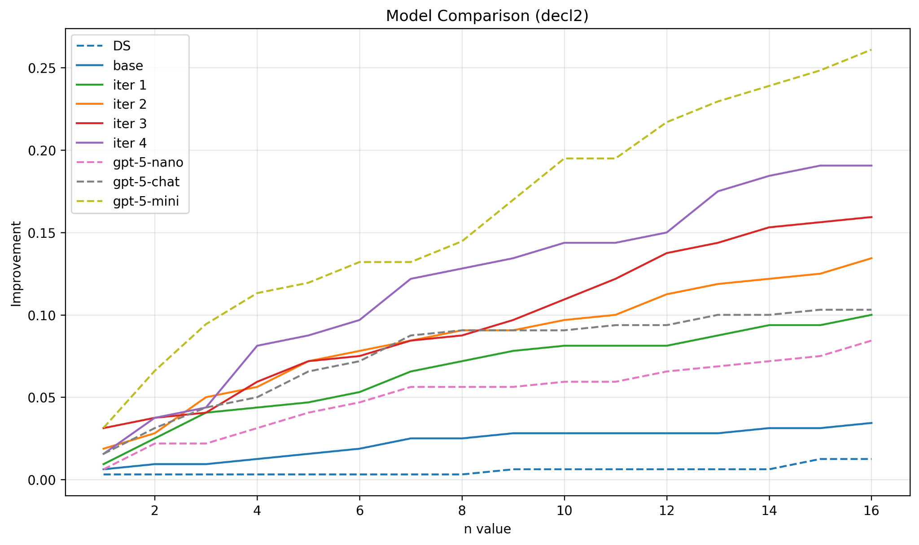
(Preliminary) Results
Results

Slide 25
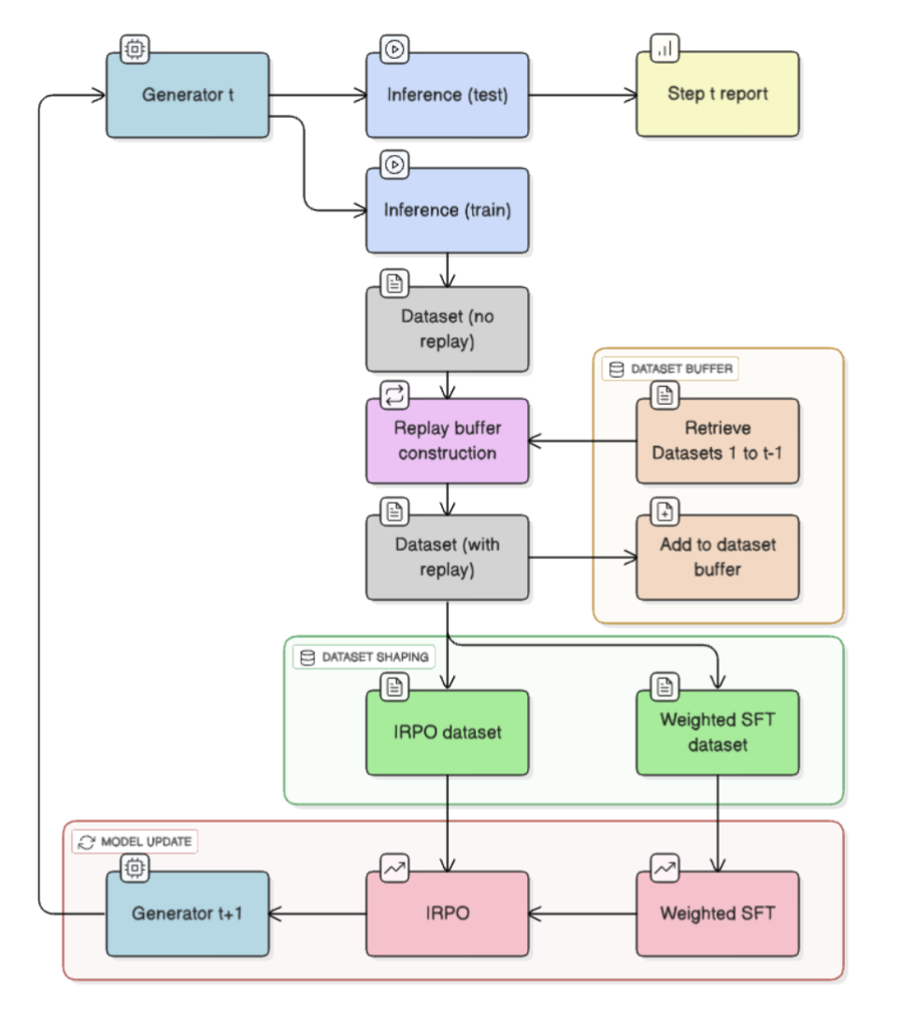
Training Pipeline
Initialize with SFT
IRPO: Iterative Reasoning Policy Optimization
With dynamic replay and difficulty filtering
Off policy, and more stable than DPO, GRPO, etc.
Bootstrapping SLMs with Off-Policy Expert Iteration

Slide 26
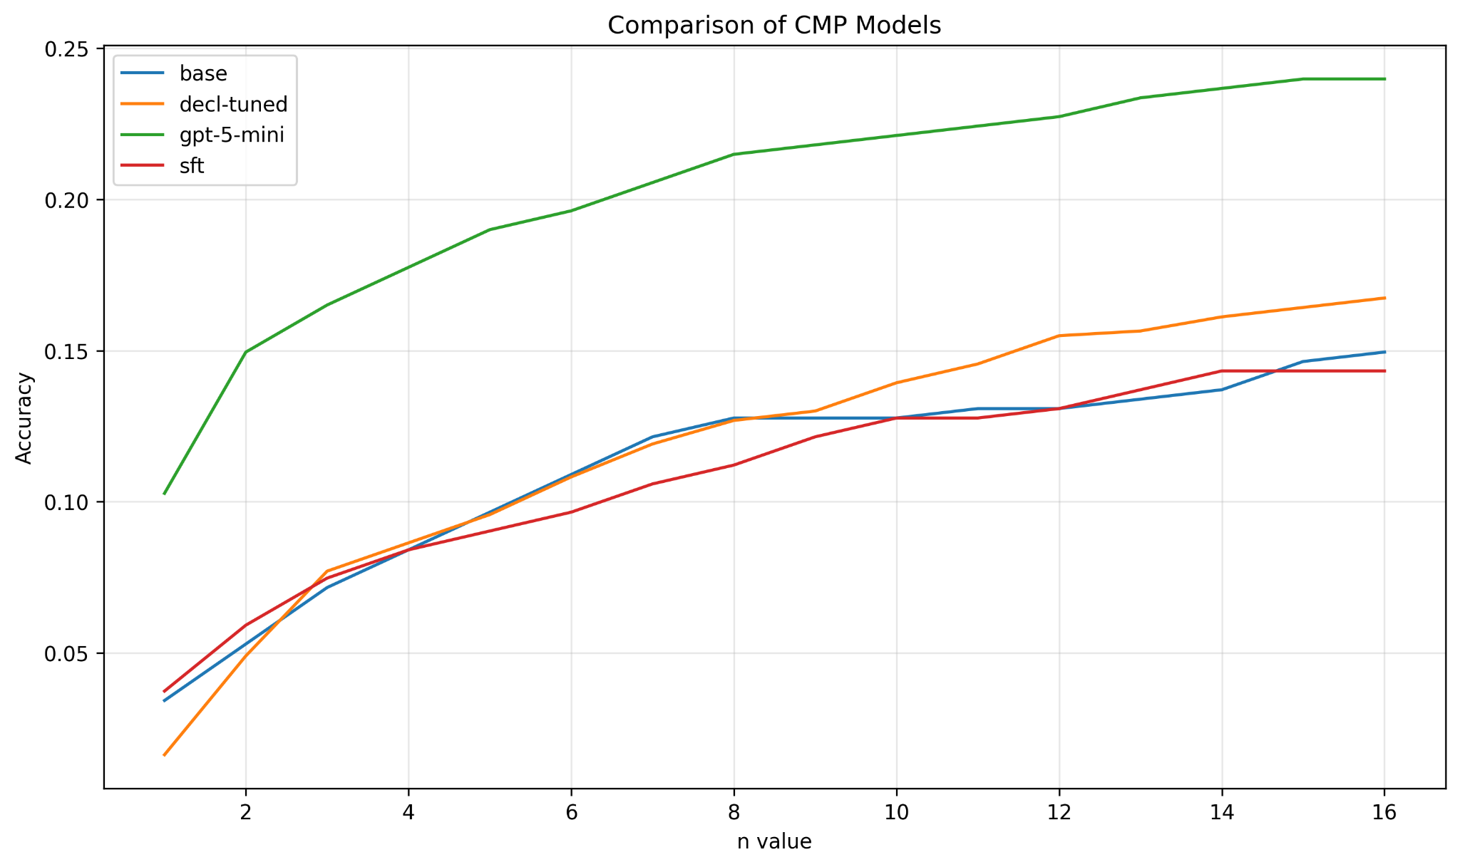
Effect on downstream theorem proving
“Structure” Is Useful

