Slide 1
ImProver: Agent-Based Automated Proof Optimization
Riyaz Ahuja

Slide 2
Automated Proof Optimization
Context
We would like a single model that can:
Minimize length
Maximize readability
Maximize efficiency
Maximize modularity
Maximize generality
Minimize similarity
Maximize correctness
Minimize complexity
…
Declaration
Declaration
Proof
Proof
Such that the new proof is “better” than the old one. What does “better” mean?

Slide 3

Table of Contents
Lean Crash Course
  Basics
  Compilation and Metaprogramming
ImProver
  APO and metrics
  Methodology
  Implementation
  Experiments and Results
  Discussion
ImProver 2
  Fine Tuning + RL
  Neurosymbolic and Hybrid architectures
qrco.de/bfRnMN

Slide 4
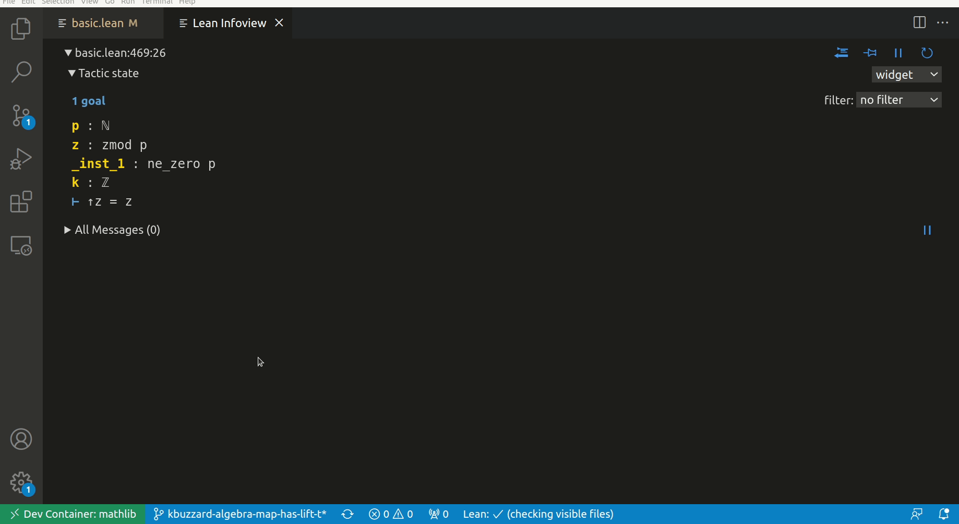

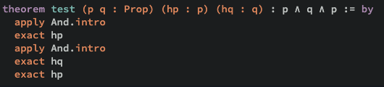
Lean Crash Course - Basics
“Lean is a functional programming language that makes it easy to write correct and maintainable code. You can also use Lean as an interactive theorem prover.” - Wise words by the Lean 4 manual
Uses Dependent Type Theory (CoC w/ inductive types)
Term rewriting, simplification, and type inference is automatically handled by Lean
Rich metaprogramming suite and active mathematical library Mathlib

Slide 5
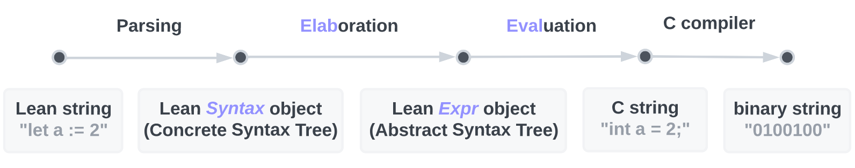
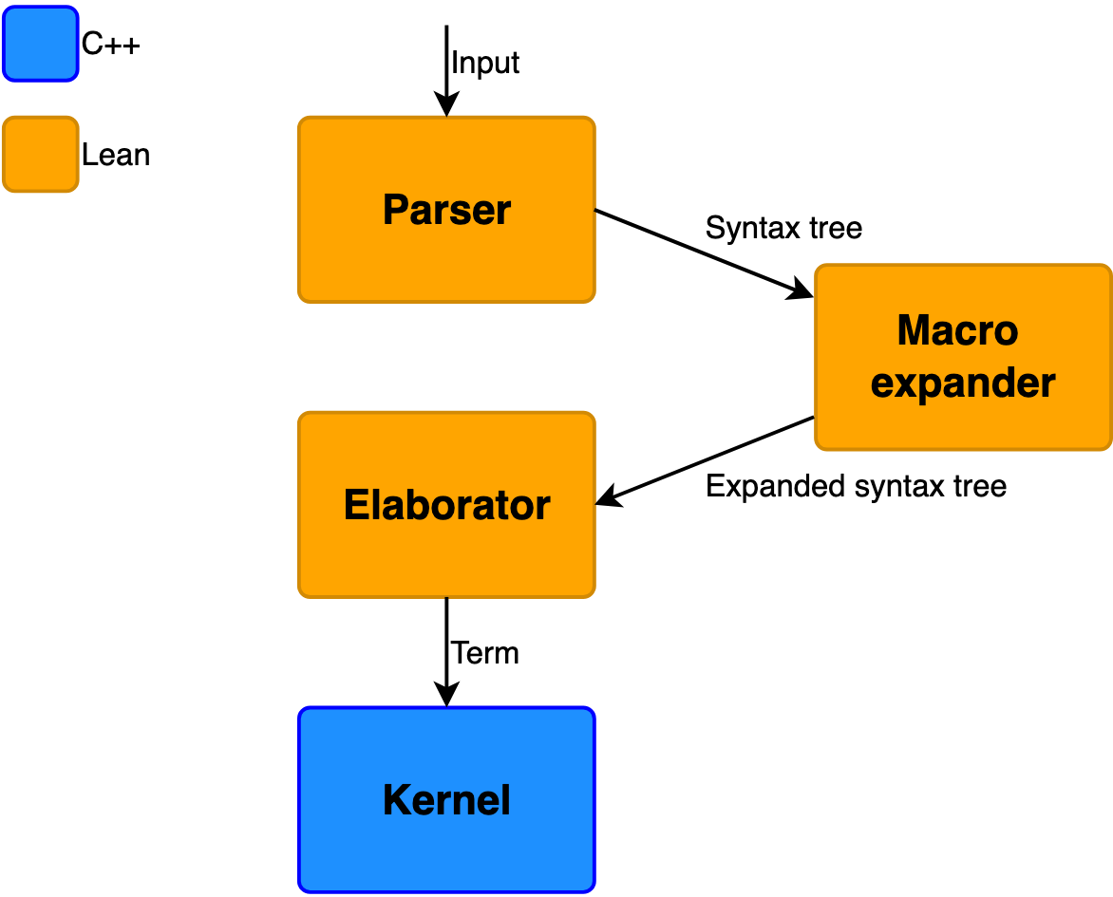
Lean Crash Course - Compilation and Metaprogramming
Parsing is essentially regex
Elaboration imbues your syntax with some meaning (i.e. fills in metavariable “holes” in a proof, replaces lemma references).
Elaborator is what tracks and ensures the correctness of the proof, with that info hidden inside Expr, and more general information (i.e. file, start, end, etc.) in Syntax objects

Slide 6
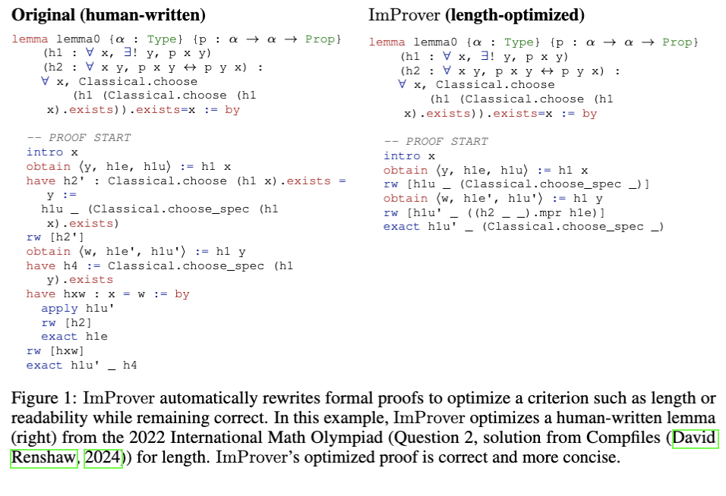
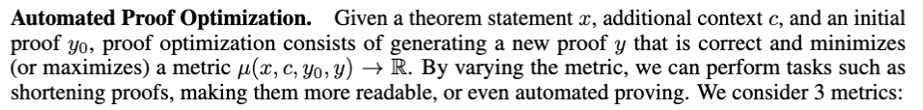
ImProver - APO and Metrics
Automated Proof Optimization: Rewrite a proof so that it is correct and optimizes an arbitrary user criterion, such as length or readability.
Length Metric: Number of tactic invocations in the tactic proof. Note that shorter proofs often represent more efficient proofs.
Readability Metric: A proof is readable if it is declarative, which is evaluated using the ratio of number of explicitly typed “have” tactics to total number of tactic invocations.
Completion Metric: The completion of a proof simply describes its correctness. This is a trivial metric which measures the number of errors present. Generalizes NTP

Slide 7

ImProver - Methodology - Overview
APO reduces to NTP/ATP, which in full generality is undecidable. However, we can still get pretty good results if we allow some error term, so consider some black-box generator:
(In practice, this will be an LLM like GPT-4o)
We improve on the base results from this generator using:
Chain-of-States
Output Formatting
Sampling Methods
RAG and Examples

Slide 8
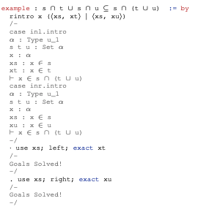

ImProver - Methodology - Chain of States
An extension of chain-of-thought for symbolically generated tactic states
rintro …
use
use
left
right
exact
exact

Slide 9
ImProver - Methodology - Output Formatting
String
Flat
Structured
rintro …
rintro …
use
use
use
use
left
right
left
right
exact
exact
exact
exact

Slide 10
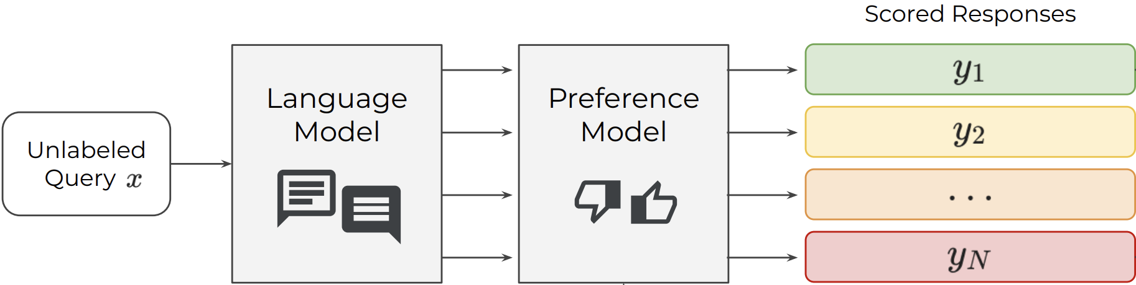
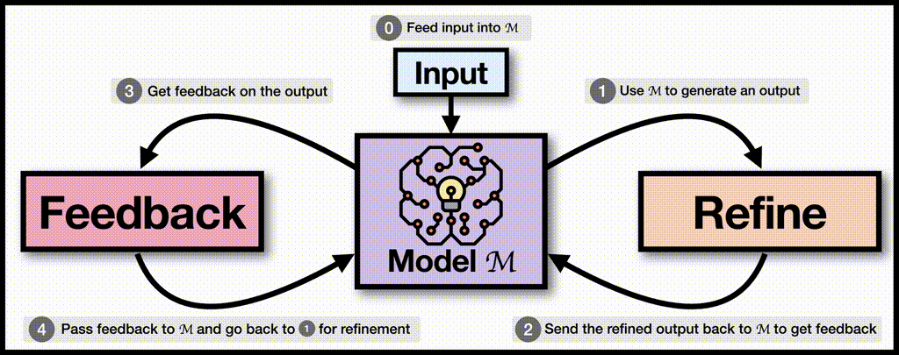
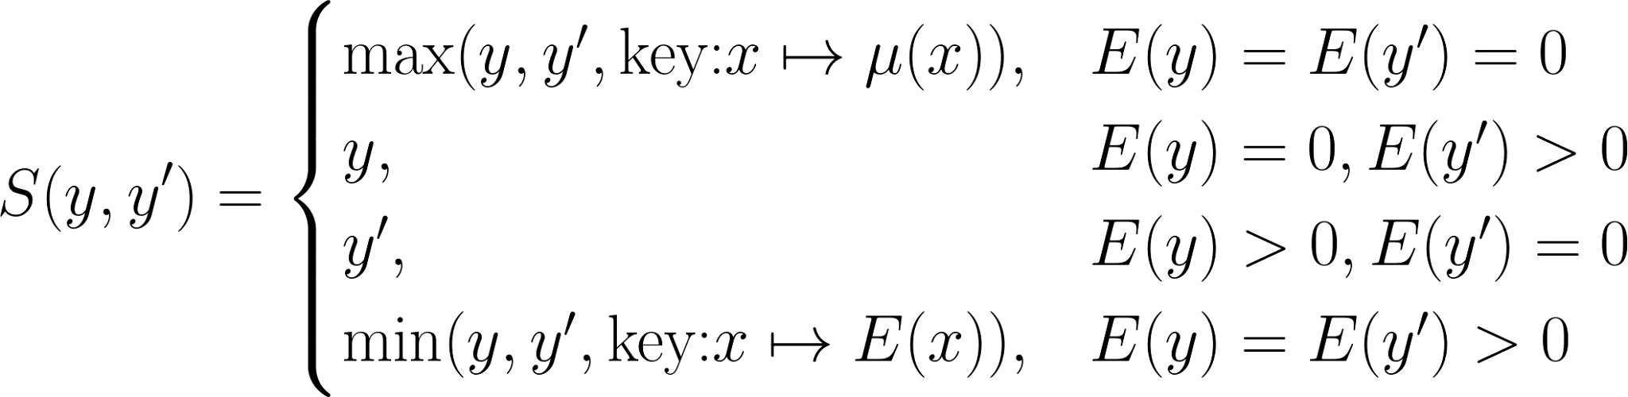
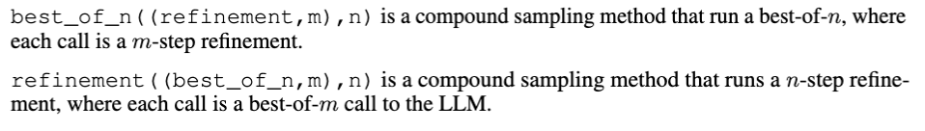
ImProver - Methodology - Sampling
We consider:
Best-of-n
Refinement
As well as compound methods like:

Slide 11
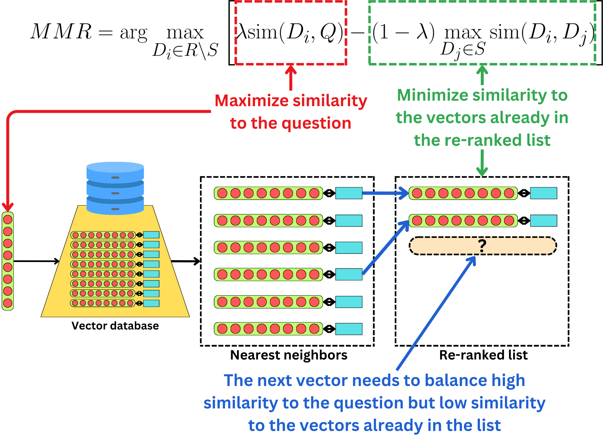
ImProver - Methodology - RAG and Examples
3 retrievers, all MMR:
Example retrieval (unique per metric)
Document retrieval (from static TPiL handbook)
Mathlib retrieval (from semantically chunked Mathlib documents)
We retrieve the most relevant k documents from each vectorDB with queries coming from the theorem and error messages.

Slide 12
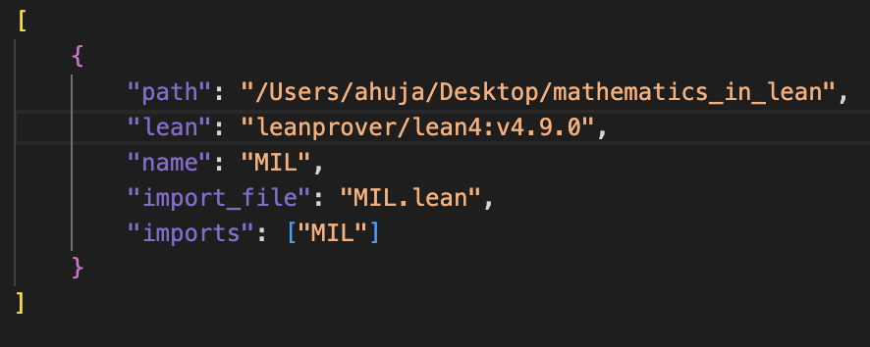
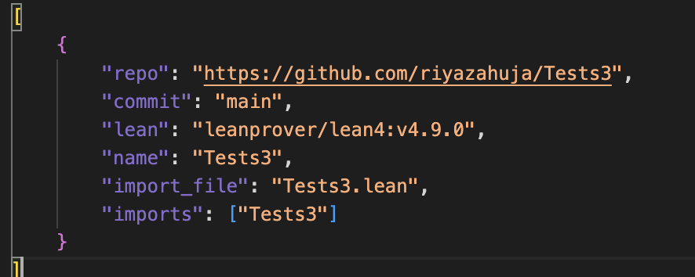
ImProver - Implementation - Build
Make a config file “configs/config.json”
Run scripts/build –config configs/config.json
Under the hood, we’re auto-generating lakefile.lean, running lake build/update/etc, and calling lake exe training_data via the shell, and piping the final output into a json file in .cache. Note: you can also specify if we update the cache + environment or just environment.
Must be v4.9.0
Local Config
.cache contents:
{
“tactics”:[
{thm start,thm end, tactic, start,end,prev state, next state, decl, declID,srcUpToTactic,declUpToTactic},...
]
“messages”=[{severity,pos,endPos,fileName,keepFullRange,data},...]
}
Github Config

Slide 13
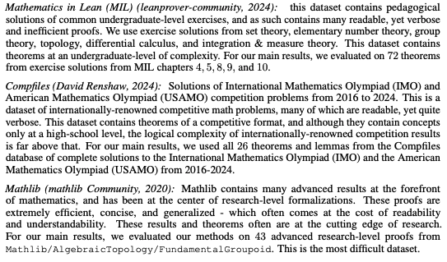
ImProver - Experiments and Results - Overview
Main Results
Ablation Testing
  Readability/CoS ablation
NTP

Slide 14
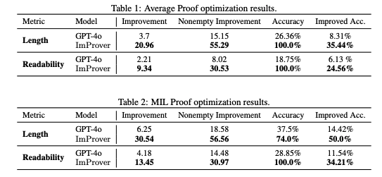
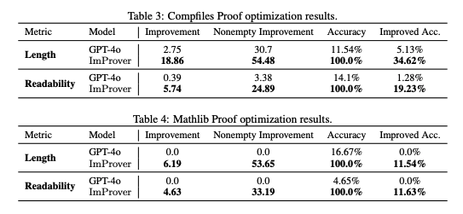
ImProver - Experiments and Results - Main Results

Slide 15
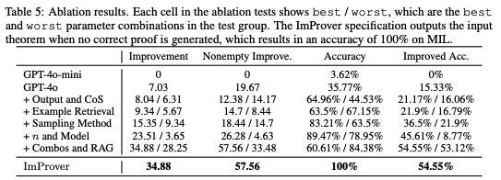
ImProver - Experiments and Results - Ablations

Slide 16
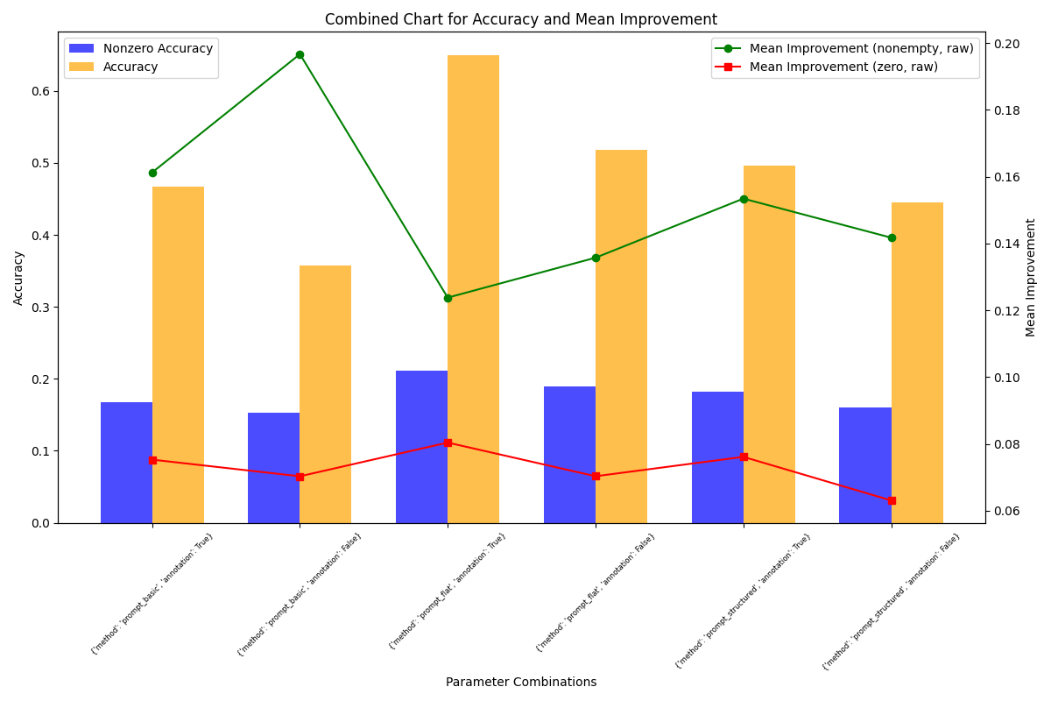
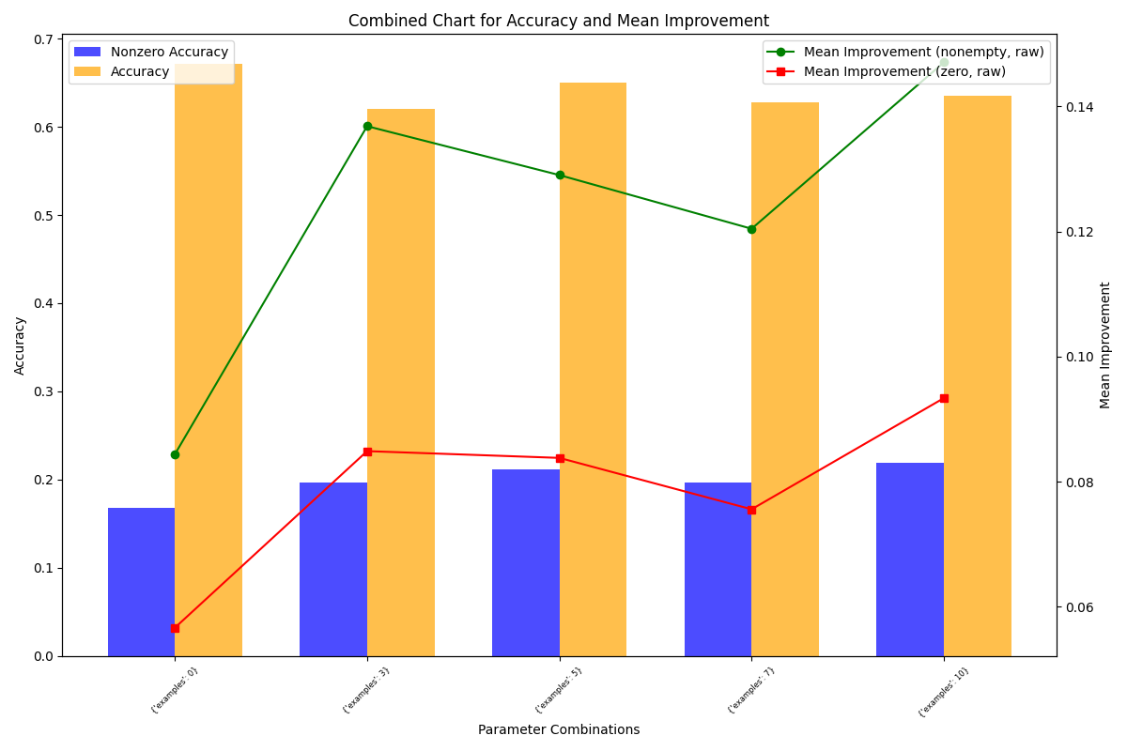
ImProver - Experiments and Results - Ablations

Slide 17
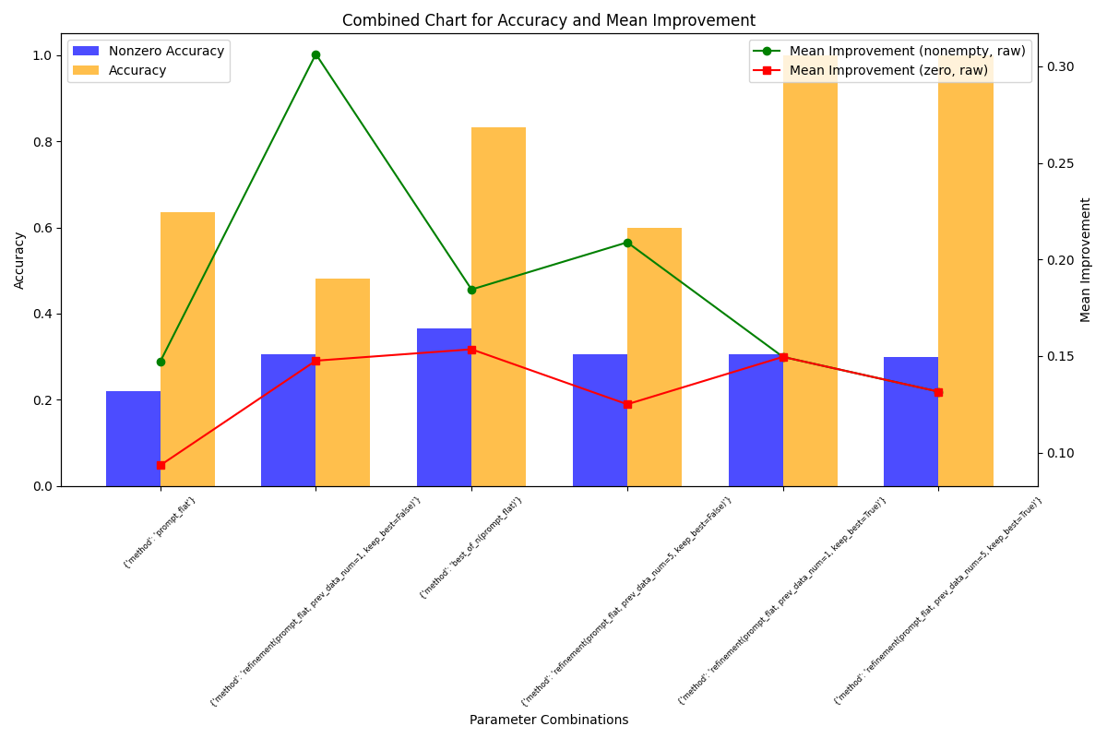
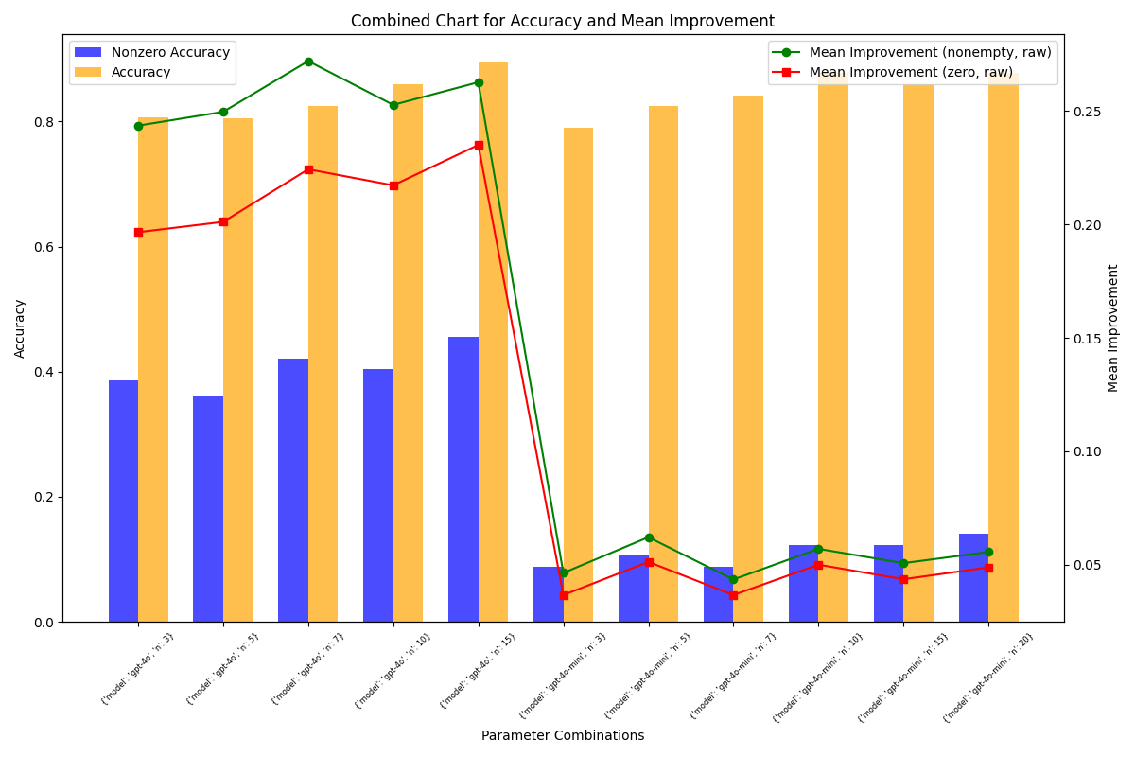
ImProver - Experiments and Results - Ablations

Slide 18
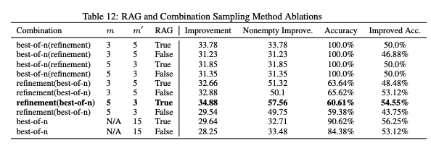
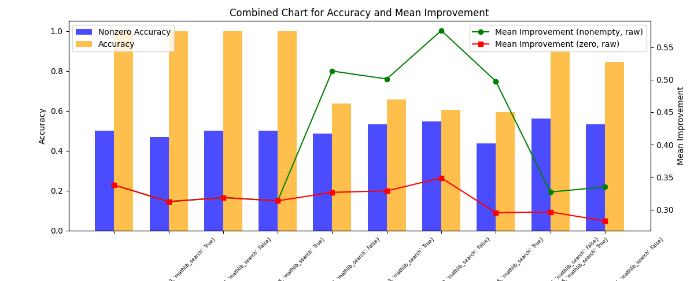
ImProver - Experiments and Results - Ablations

Slide 19
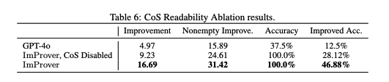

ImProver - Experiments and Results - Ablations, NTP

Slide 20
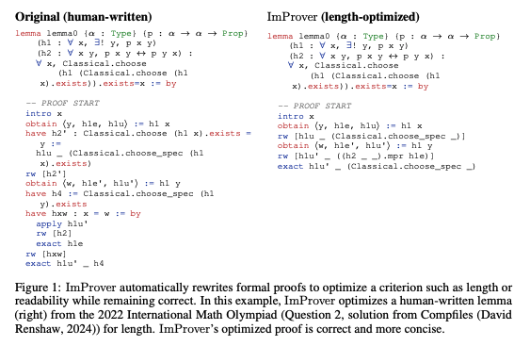
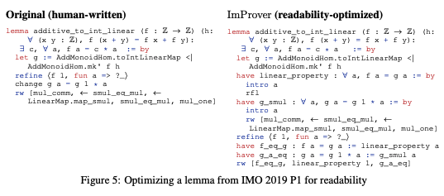
ImProver - Experiments and Results - Examples

Slide 21
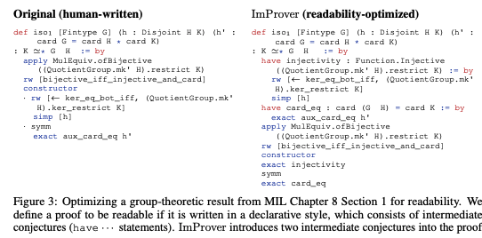
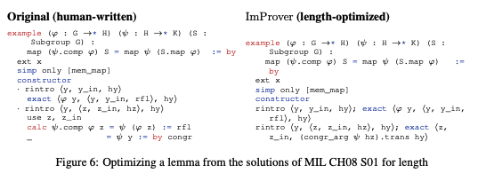
ImProver - Experiments and Results - Examples

Slide 22
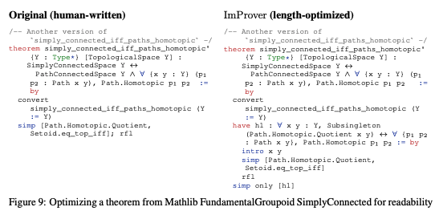
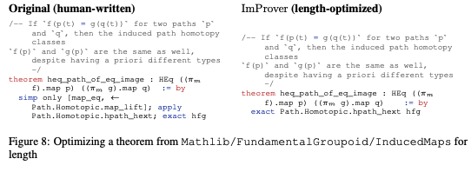
ImProver - Experiments and Results - Examples

Slide 23
ImProver - Discussion
ImProver outperforms base GPT-4o significantly over all metrics and datasets
Bottleneck comes from ability of GPT-4o to generate correct, new proofs, not from its ability to optimize.
Shows potential for significant future advancement in APO problems for a generalized ATP, APO, autoformalization suite.
Limitations:
Extremely Slow
Extremely Costly
Even with high cost, generalizability to a general-purpose tool is limited without further integration in ATP and autoformalization aspects
Fixes:
New Architecture
Switch out GPT-4o
Integrate framework for empty template proofs (done) and informal template proofs (todo)
Consider alternative generation methods

Slide 24
ImProver2 and Beyond
Rather than using a python driver with a lean backend, fully integrate into a Lean-based ML suite, only relying on Python for integrating with vector databases.
Using the large corpus of data collected and optimized from ImProver, we can distill its knowledge into a fine tuned smaller, cheaper, faster model.
Using our metrics, we can improve optimization scores by RL (PPO/DPO) with our metric functions as reward functions
Rather than generating the entire proof, generate tactic by tactic, or recursively generate (improves on deepseek 1.5)
Using the frameworks for implementing all the above, we can alternatively train some heuristic on some tree search (MCTS) that we can optimize against.
Input
Recursive Generation
Structured
Eval
Sorry Gen
Sorry eval
Output
Subthm Gen

